Slide 1

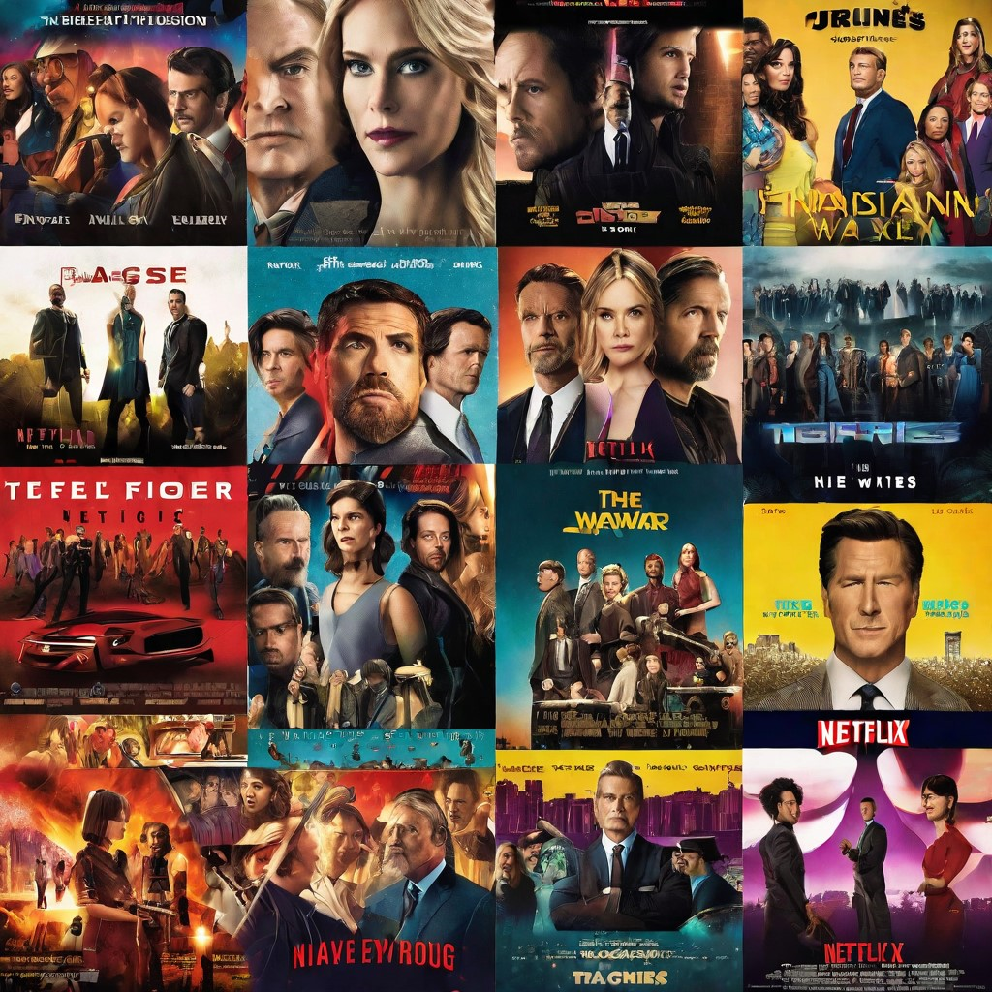
CAPSTONE PROJECT: Clustering Netflix TV Shows & Movies PRESENTED BY:- DOLLY BAGHEL

Slide 2
This machine learning project aims to cluster Netflix TV shows and movies based on their genre, cast, and other features. The objective of this project is to improve the user experience on Netflix by providing personalized recommendations based on their viewing history and preferences.
Goals
Develop a clustering algorithm to group similar TV shows and movies.
Analyze user data to personalize recommendations and improve user experience.
Objectives
Collect and preprocess data on Netflix TV shows and movies.
Develop and train a clustering algorithm using machine learning techniques.
Evaluate the performance of the clustering algorithm using appropriate metrics.
Implement the clustering algorithm and personalized recommendation system on Netflix's platform.

Slide 3
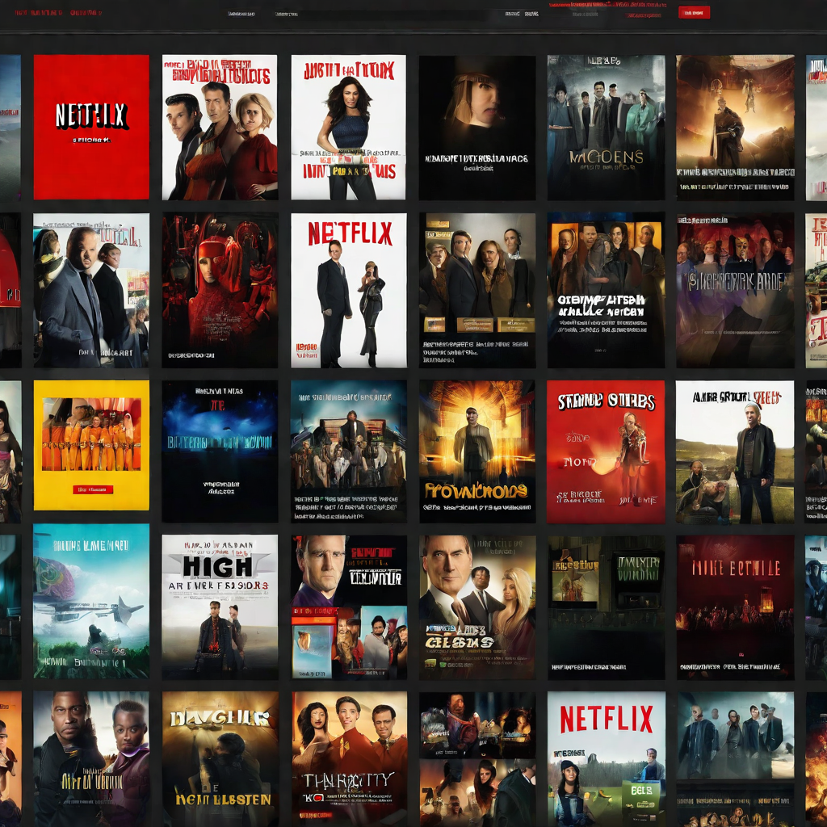
Data Collection & Preprocessing
The first step in our machine learning project was to collect data on Netflix TV shows and movies. We used a web scraping tool to extract information from the Netflix website, including the title, description, genre, and release year of each TV show or movie.
Once we had collected the data, we needed to preprocess it in order to prepare it for clustering. This involved several steps, including:
Cleaning the data: We removed any duplicate entries and corrected any errors in the data that we had collected.
Text preprocessing: We used natural language processing techniques to preprocess the text data, including tokenization, stopword removal, and stemming. This helped to standardize the text data and reduce its dimensionality.
Feature extraction: We used feature extraction techniques to convert the text data into numerical features that could be used for clustering. We used both bag-of-words and TF-IDF representations for this purpose.

Slide 4
Exploratory Data Analysis
Overview of Dataset
The Netflix dataset contains information about TV shows and movies available on the streaming platform. The dataset includes attributes such as title, director, cast, country, release year, rating, and genre.
Data Cleaning
Before performing any analysis, the dataset was cleaned by removing duplicates and missing values. The 'date_added' column was converted to datetime format for further analysis.
Visualizations
Several visualizations were created to explore the distribution of the data and identify any patterns or trends.
Distribution of TV Shows and Movies by Release Year
The above histogram shows the distribution of TV shows and movies by release year. The majority of the content was added to Netflix in the past decade, with a peak in 2018. This suggests that Netflix has been rapidly expanding its library in recent years.
Top 10 Countries with the Most Content on Netflix
The above bar chart shows the top 10 countries with the most content on Netflix. The United States has by far the most content, with over 5000 titles. This is followed by India, the United Kingdom, and Canada.
Insights
Based on the exploratory data analysis, several insights can be drawn:
Netflix has been rapidly expanding its library in recent years, with a peak in content added in 2018.
The United States has the most content on Netflix, followed by India, the United Kingdom, and Canada.

Slide 5
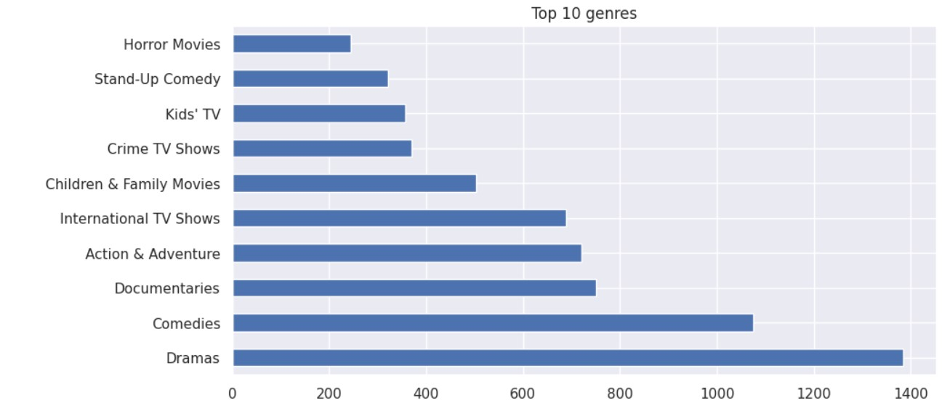
TOP 10 GENRES On Netflix, the prevailing genres that capture viewer attention are dramas, comedies, and documentaries. These categories stand out as the top choices, reflecting a diverse and inclusive range of content preferences Netflix caters to a broad audience by offering a rich tapestry of storytelling across these prominent genres.

Slide 6
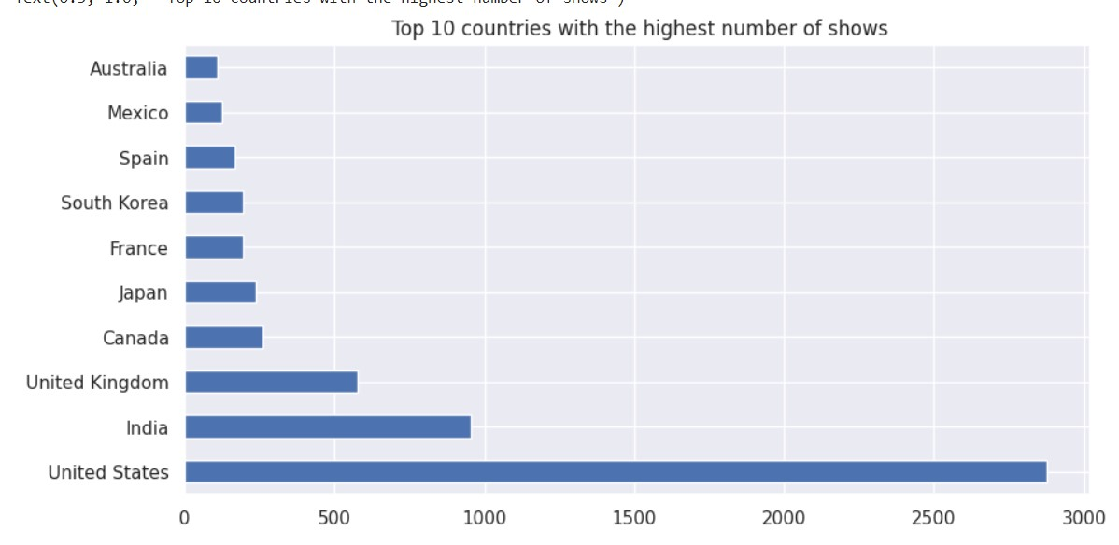
A significant majority of content on platforms like Netflix originates from key global entertainment hubs, particularly the United States, the United Kingdom, and India. The streaming platform's extensive library reflects a global tapestry, with a prominent emphasis on content produced in these influential and prolific countries

Slide 7
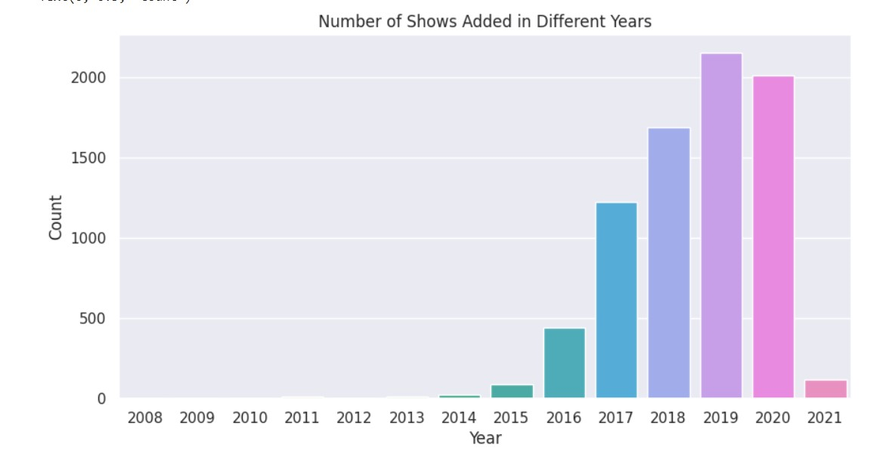
Richard Branson

Slide 8
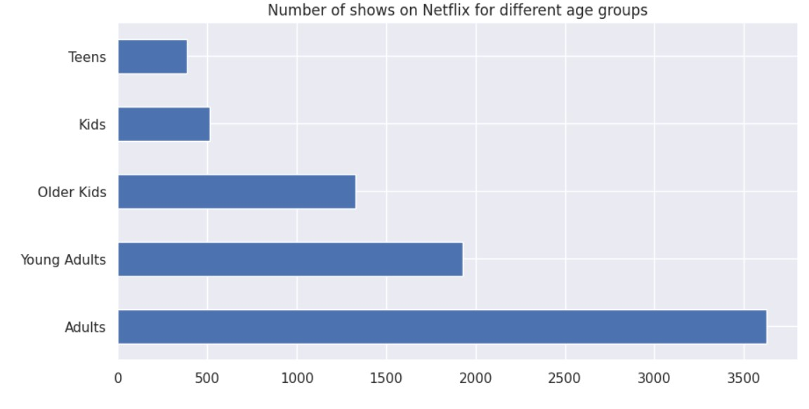
Number of shows for different age groups The majority of the shows on Netflix are catered to the needs of adult and young adult population

Slide 9
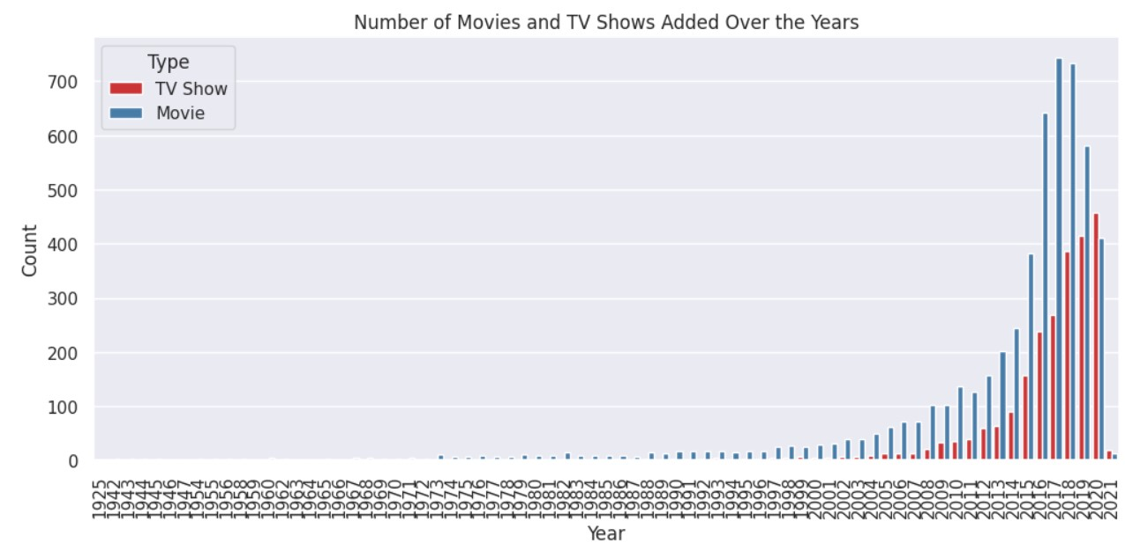
Number of movies and TV Shows added over the years More movies were added on Netflix till 2019. More TV Shows were added from 2020.

Slide 10
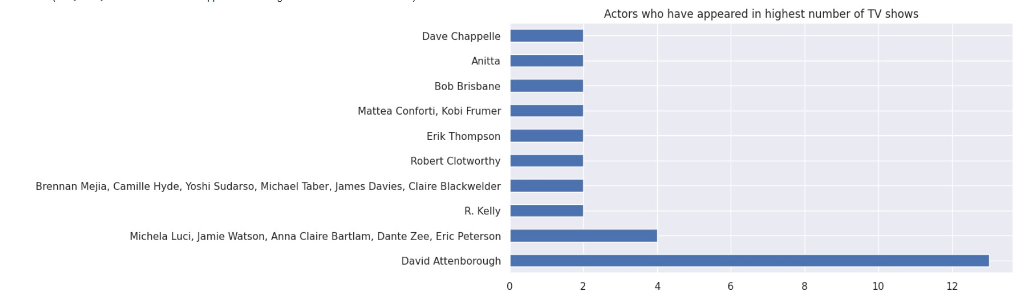
Actors who have appeared in most TV shows David Attenborough leads the roster of actors who have made the most appearances in TV shows on Netflix, establishing a remarkable presence on the platform. Following closely are Michela Luci and Jamie Watson, both contributing significantly to the diverse array of television content available for viewers on Netflix.

Slide 11
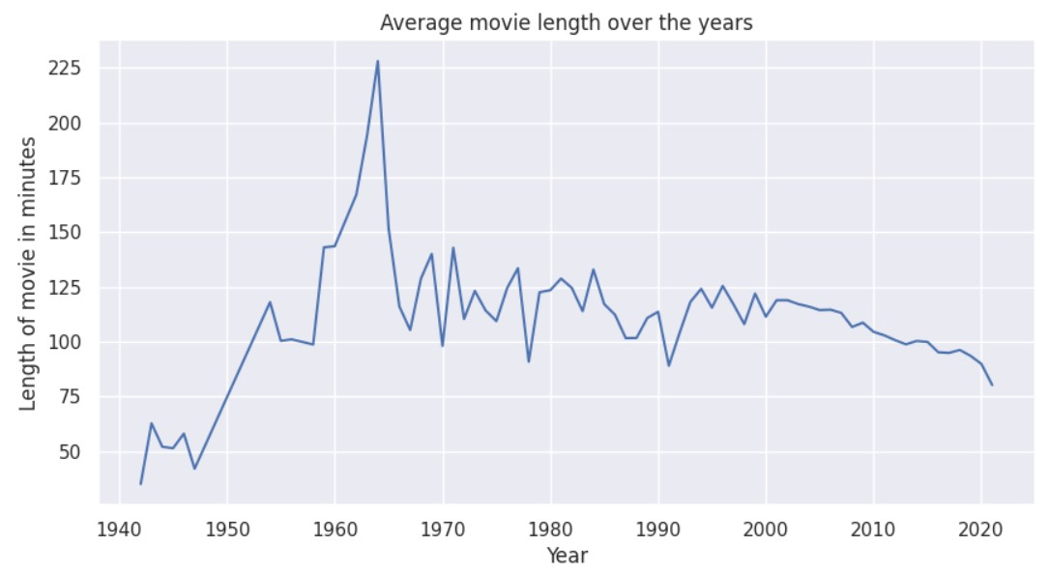
Average movie length over the years In recent years, there has been a noticeable shift in the length of movies available on Netflix. While films in the 2000s tended to have longer runtimes, it appears that the trend has evolved towards shorter durations. This shift could be attributed to changing viewer preferences, a desire for more concise storytelling, and the convenience of consuming shorter content in a single sitting

Slide 12
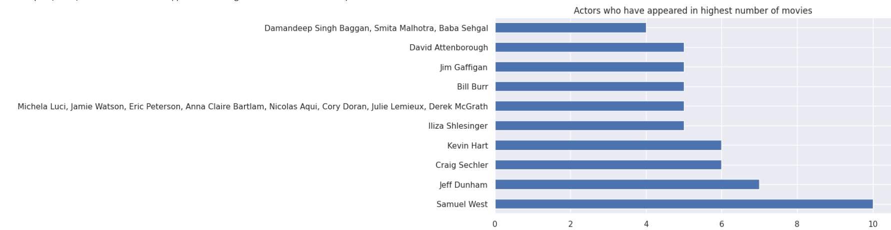
Actors who have appeared in highest number of movies Samuel L. Jackson, Jeff Dunham, Craig Sechler, and Kevin Hart stand out as actors who have made a significant impact on Netflix, each having appeared in a substantial number of movies on the platform

Slide 13
Natural Language Processing (NLP) Introduction: "NLP Unveiled: Harnessing the power of Natural Language Processing (NLP) to understand, interpret, and derive meaningful insights from human language." Contextual Understanding: Beyond Words: NLP enables machines to comprehend the context, nuances, and sentiments embedded in human language, fostering a deeper understanding." Text Processing Power: "From Words to Data: Transforming unstructured text into structured data, NLP empowers machines to analyze, categorize, and extract valuable information from vast textual datasets." Application Spectrum: "Versatility in Action: NLP finds application across diverse domains, from sentiment analysis and chatbots to document summarization and language translation." Entity Recognition: "Spotlight on Entities: NLP's ability to identify entities such as names, locations, and organizations enhances information extraction and knowledge discovery." Sentiment Analysis: Intelligence: Through sentiment analysis, NLP interprets the emotional tone within text, providing valuable insights into user opinions and reactions." Machine Translation: Language Barriers: NLP powers machine translation, facilitating communication across languages and fostering global connectivity." Voice Interfaces: "Voice-Activated Interaction: NLP contributes to the development of voice interfaces, enabling seamless communication between users and devices." Personalized Experiences: "Tailoring Interactions: By understanding user preferences and behaviors, NLP enables the delivery of personalized experiences in applications ranging from content recommendations to virtual assistants." Continuous Advancements: "Innovation at its Core: NLP continues to evolve, with advancements in deep learning and neural networks pushing the boundaries of language understanding and automation." rnessing the power of Natural Language Processing (NLP) to understand, interpret, and derive meaningful insights from human language.

Slide 14
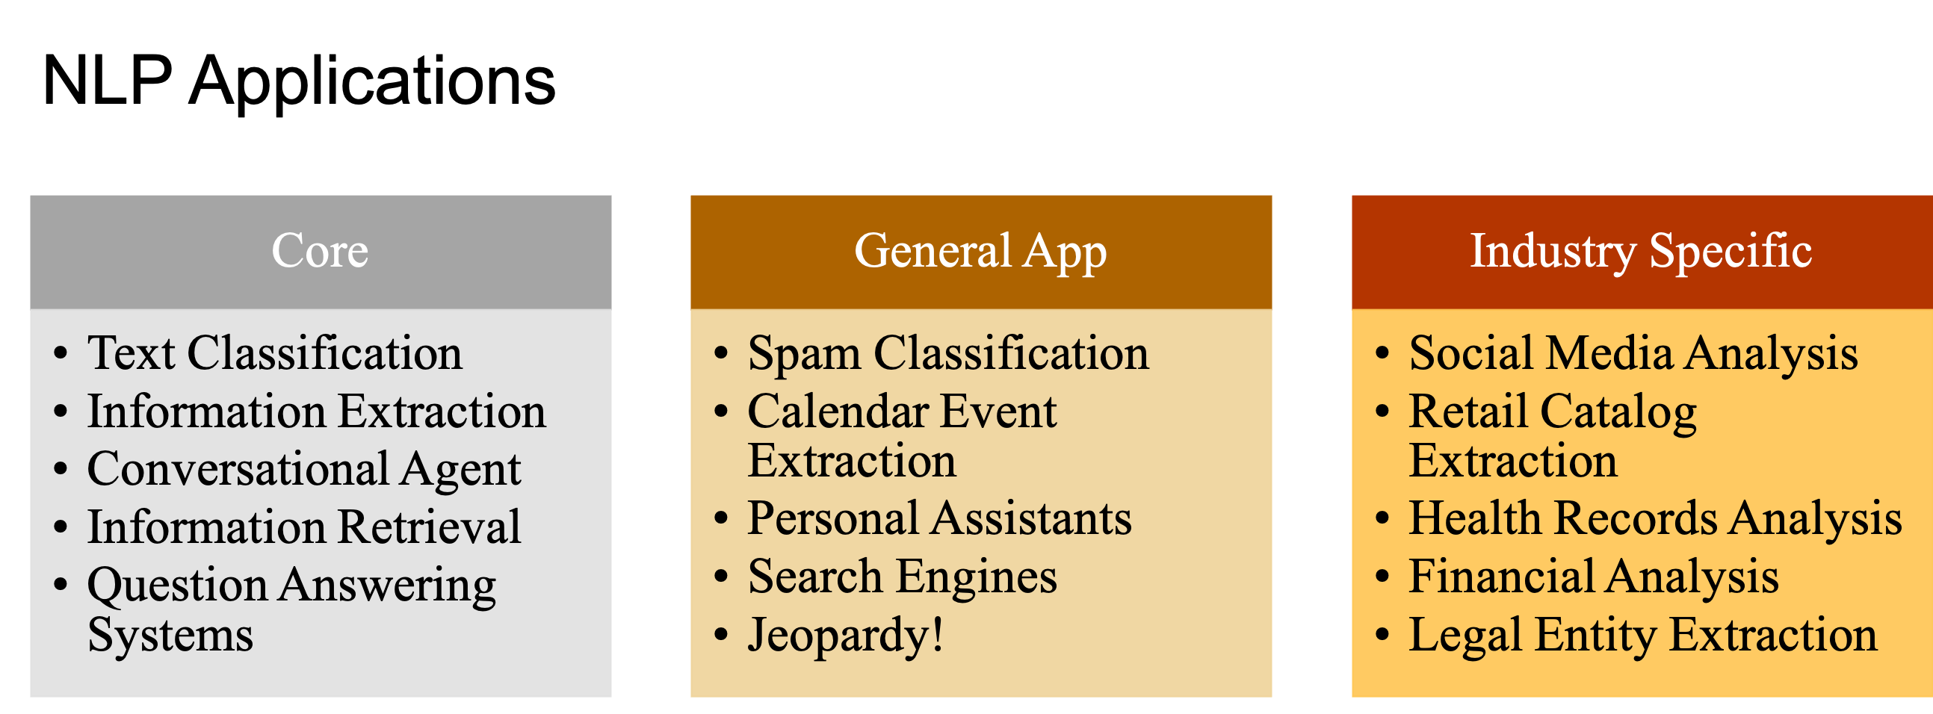
understand, interpret, and derive meaningful insights from human language.

Slide 15
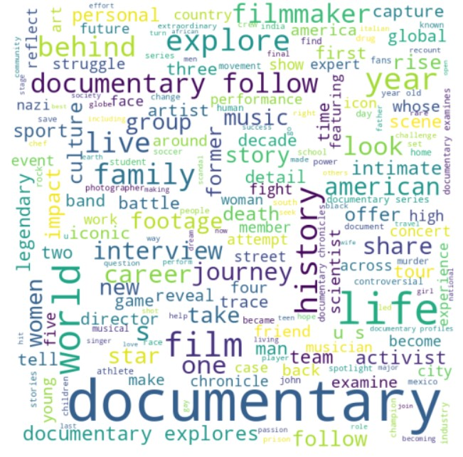
Word Cloud of Custer1 ightumag

Slide 16
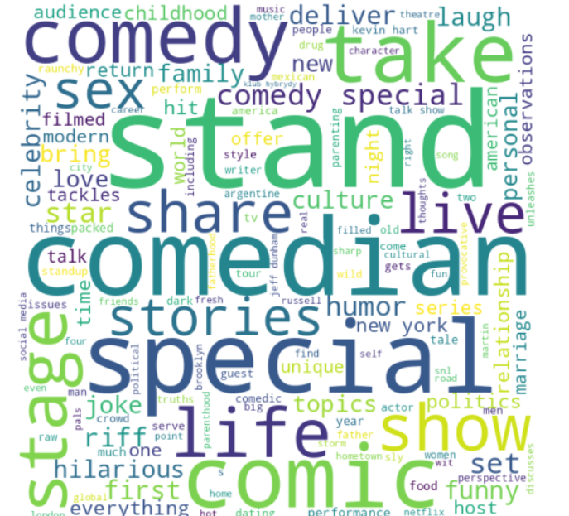
Word Cloud of Cluster2 ightumag

Slide 17
Text Preprocessing
Clean and preprocess the text data by removing stop words, punctuation, and special characters. Convert the text to lowercase to ensure uniformity.
Tokenization
Tokenize the descriptions into individual words or phrases. This step breaks down the text into its basic units for analysis.
Vectorization
Convert the tokenized words into numerical vectors using techniques like TF-IDF (Term Frequency-Inverse Document Frequency) or word embeddings (Word2Vec, GloVe). This step transforms the text data into a format suitable for machine learning algorithms.
Clustering Algorithm
Choose a clustering algorithm suitable for your task. K-means clustering is a popular choice. Ensure that the algorithm takes into account the numerical vectors derived from the descriptions.
Determine Optimal Number of Clusters
Use this information and create a page for exploring the applications of NLP in clustering Netflix TV shows and movies, including sentiment analysis and text classification
Cluster Analysis

Slide 18
K-Means Clustering K-means clustering is a popular unsupervised learning algorithm used to partition data into K clusters. It works by iteratively assigning data points to the nearest cluster center and updating the center based on the mean of the assigned points. The algorithm continues until the cluster centers no longer change or a maximum number of iterations is reached. Strengths: Efficient and scalable for large datasets. Easy to implement and interpret results. Weaknesses: Sensitive to initial cluster centers and can converge to suboptimal solutions.
Hierarchical
Clustering
Hierarchical clustering is another popular unsupervised learning algorithm used to group data into clusters. It works by iteratively merging the closest pairs of clusters until all data points belong to a single cluster or a maximum number of clusters is reached.
Strengths:
Does not require a pre-specified number of clusters.
Weaknesses:
Computationally expensive for large datasets.

Slide 19
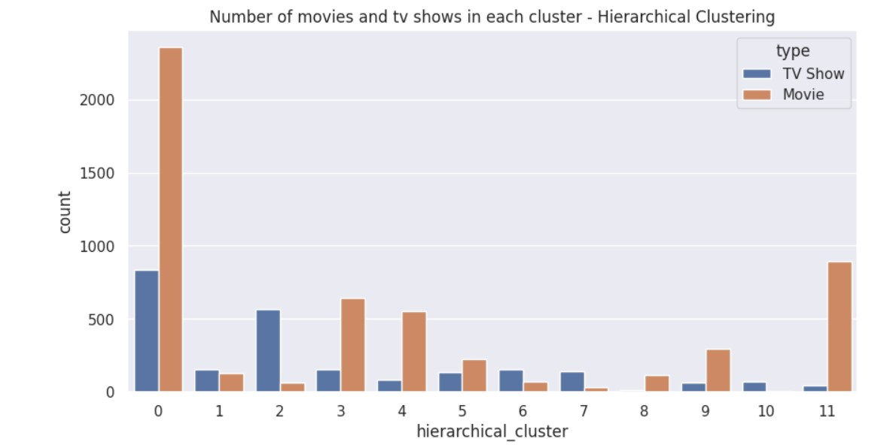

Slide 20
Cluster 0: Diverse Content Mix (Approximately 900 TV Shows, 2080 Movies)
Cluster 0 showcases a diverse mix of content, with a substantial presence of both TV shows (approximately 900) and movies (approximately 2080).
Cluster 1: Limited Content (Approximately 100 TV Shows, 80 Movies)
In Cluster 1, there's a relatively smaller collection of both TV shows (approximately 100) and movies (approximately 80).
Cluster 2: TV Show Dominant (Approximately 520 TV Shows, 50 Movies)
Cluster 2 is characterized by a focus on TV shows, with around 520, complemented by a smaller number of movies (approximately 50).
Cluster 3: Movie Dominant (Approximately 80 TV Shows, 550 Movies)
In Cluster 3, movies take the spotlight with a significant count of approximately 550, while there's also a notable presence of TV shows (around 80).
Cluster 4: Balanced Mix (Approximately 50 TV Shows, 520 Movies)
Cluster 4 maintains a balanced mix of TV shows (approximately 50) and movies (approximately 520).
Cluster 5: Even Mix (Approximately 100 TV Shows, 200 Movies)
Cluster 5 presents an even mix of TV shows (approximately 100) and movies (approximately 200).

Slide 21
Cluster 6: Limited Content (Approximately 100 TV Shows, 80 Movies)
Similar to Cluster 1, Cluster 6 features a relatively smaller collection of both TV shows (approximately 100) and movies (approximately 80).
Cluster 7: Limited Content (Approximately 100 TV Shows, 50 Movies)
Cluster 7 has a modest collection of both TV shows (approximately 100) and movies (approximately 50).
Cluster 8: Exclusive Movies (Approximately 150)
Cluster 8 exclusively focuses on movies, with a count of approximately 150.
Cluster 9: Movie Dominant (Approximately 50 TV Shows, 300 Movies)
In Cluster 9, movies take precedence with around 300, accompanied by a smaller number of TV shows (approximately 50).
Cluster 10: Exclusive TV Shows (Approximately 100)
Cluster 10 is exclusively comprised of TV shows, with a count of approximately 100.
Cluster 11: TV Show Dominant (Approximately 50 TV Shows, 900 Movies)
Cluster 11 is characterized by a focus on TV shows (around 50) with a substantial number of movies (approximately 900).

Slide 22
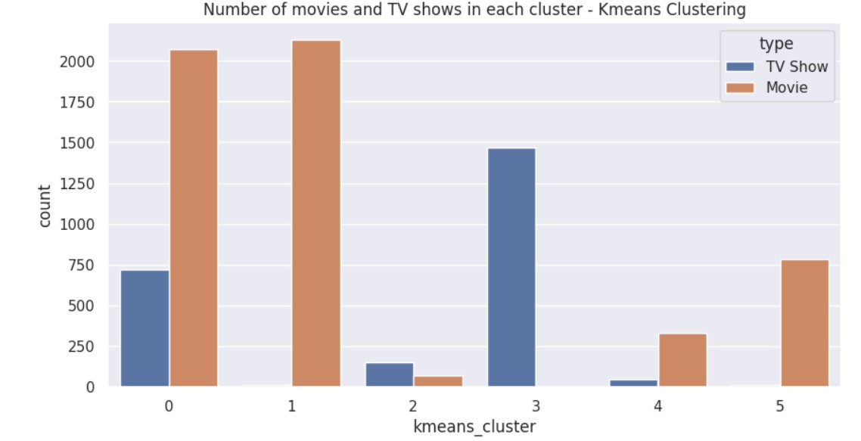

Slide 23
Cluster 0: Balanced Mix (Approximately 2020 TV Shows, 748 Movies)
This cluster displays a balanced mix of TV shows and movies, with a predominant presence of TV shows (around 2020) and a substantial number of movies (approximately 748).
Cluster 1: Exclusive Movies (Approximately 770)
Cluster 1 is characterized by an exclusive focus on movies, with approximately 770 films.
Cluster 2: TV Shows and Movies Mix (Approximately 248 TV Shows, 125 Movies)
Cluster 2 exhibits a mix of TV shows and movies, leaning slightly towards TV shows with approximately 248, and featuring around 125 movies.
Cluster 3: Exclusive TV Shows (Approximately 100)
Cluster 3 is composed solely of TV shows, with approximately 100 in total, and a smaller number of movies (approximately 275).
Cluster 4: Exclusive Movies (Approximately 770)
Similar to Cluster 1, Cluster 4 is characterized by an exclusive focus on movies, boasting around 770 films.

Slide 24
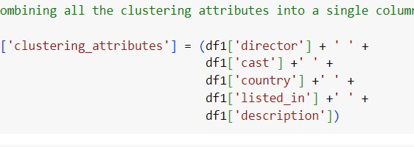
The clustering attributes encompass various facets, including director, cast, country, listed_in, and description.
This multifaceted approach allows the system to group content based on key elements such as the creative minds behind the production (director), the ensemble of actors (cast), geographical origin (country), thematic categorization (listed_in), and a textual summary capturing the essence of the content (description).
By considering this rich set of attributes, the clustering mechanism aims to provide nuanced and comprehensive groupings that enhance the precision of content recommendations.

Slide 25
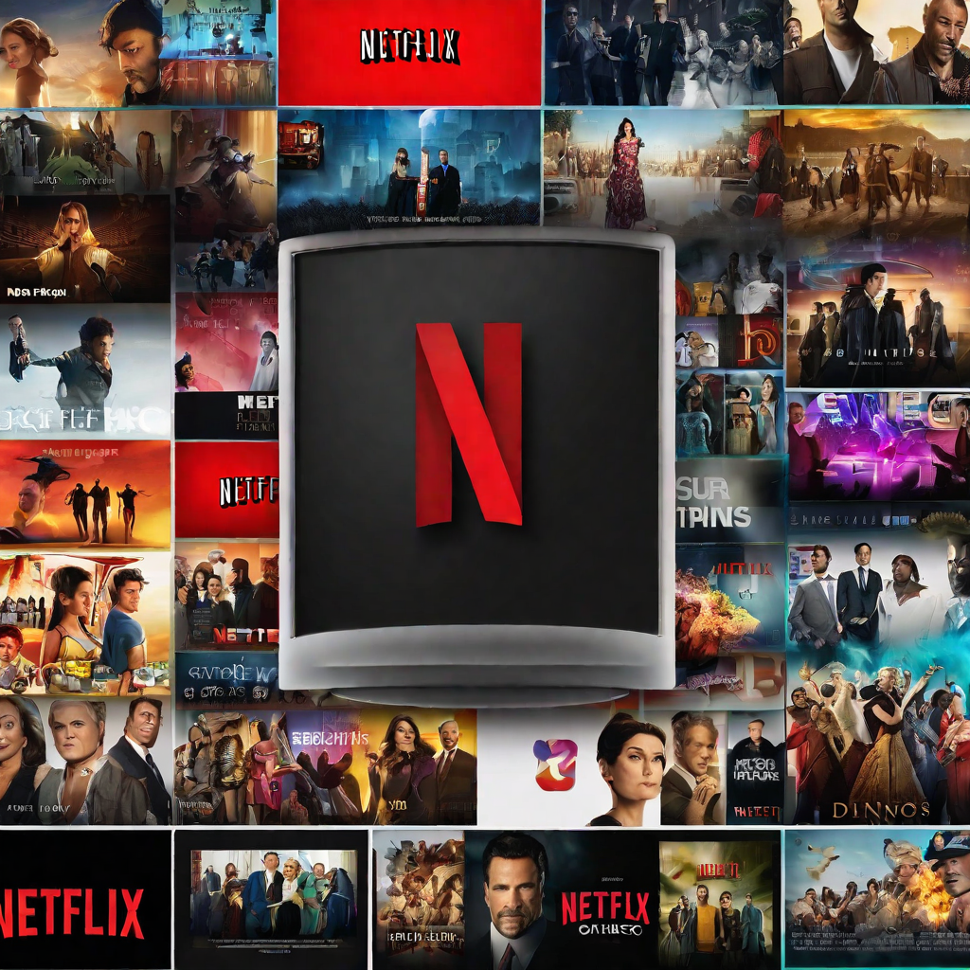

How it Works Our recommendation system uses the clustering results to suggest TV shows and movies to users based on their viewing history and preferences.
Personalization
By analyzing the user's viewing history and preferences, our system can provide personalized recommendations that are tailored to their interests.

Slide 26
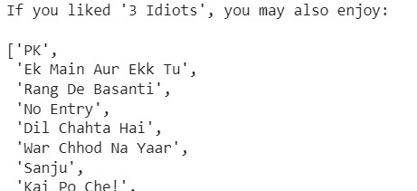

Slide 27
When searching for '3 Idiots,' the recommender system suggests a curated list of movies that share thematic or genre similarities. The recommendations include:
PK
Ek Main Aur Ekk Tu
Rang De Basanti
No Entry
Dil Chahta Hai
War Chhod Na Yaar
Sanju
Kai Po Che!
Pyaar Ka Punchnama 2
Dil Dhadakne Do
These movies are recommended based on factors such as storyline, genre, or shared characteristics, offering a selection that aligns with the viewer's interest in '3 Idiots.'

Slide 28
Limitations of the Project
While the project has shown promising results, there are still some limitations that need to be addressed.
Limited dataset: The dataset used in this project only includes a small portion of Netflix's library. In order to improve the accuracy of the clustering, a larger and more diverse dataset would be needed.
Subjectivity: The clustering was based on the keywords assigned to each TV show or movie by Netflix. However, these keywords can be subjective and may not accurately represent the content of the show or movie. A more objective approach to clustering would be needed.

Slide 29
Future Work
There are several potential areas for future work that could improve the accuracy and usefulness of the clustering results.
Incorporate user feedback: In order to make the clustering more accurate and relevant to users, it would be helpful to incorporate feedback from users on how they would categorize different TV shows and movies.
Explore other clustering algorithms: While the k-means algorithm used in this project was effective, there may be other algorithms that could produce even better results.
Incorporate more data sources: In addition to the keywords assigned by Netflix, incorporating other data sources such as reviews or ratings could improve the accuracy of the clustering.

Slide 30

Thank you
PRESENTED BY:DOLLY BAGHEL

